Slide 1

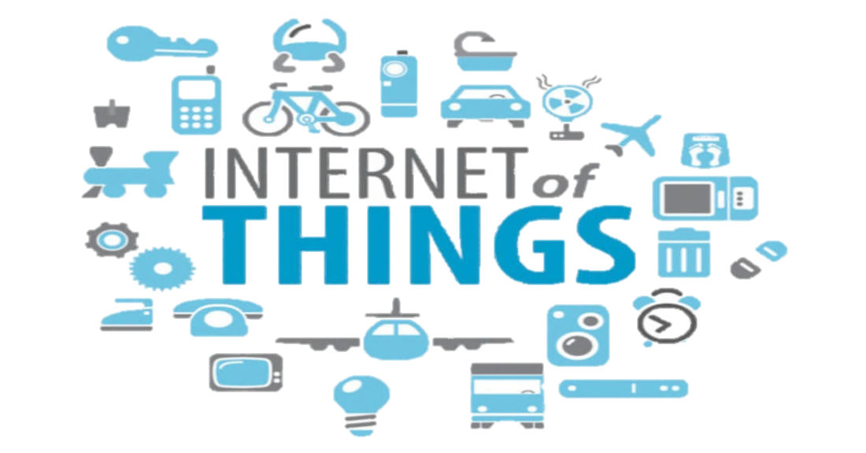
Prasad Institute of technology
Department of Computer Science & Eng.
Presents
A magical presentation on
Presented by:-
Sonal shukla
Ankita singh

Slide 2
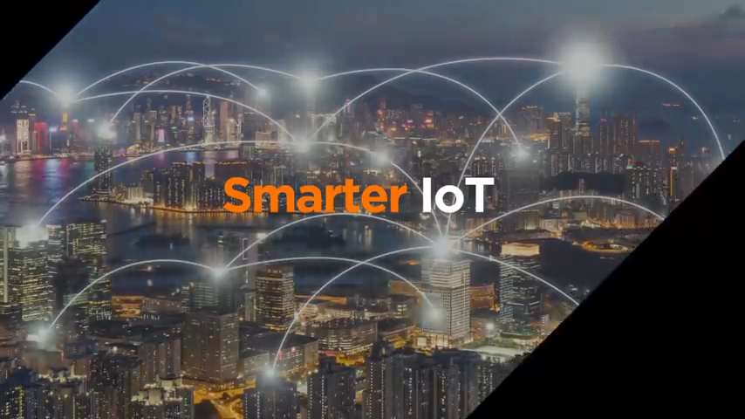

Slide 3
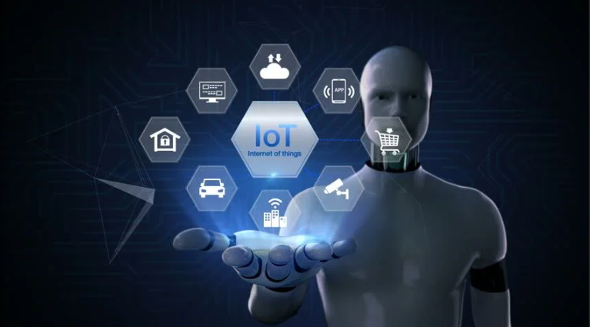
IOT OVERVIEW:-
Introduction Internet of thing?
History
Flowchart of IoT
How IoT works?
Applications of IoT
Sensors even in holy cow
Future Scope of IoT
Challenges of IoT
Advantage and disadvantage of IoT

Slide 4
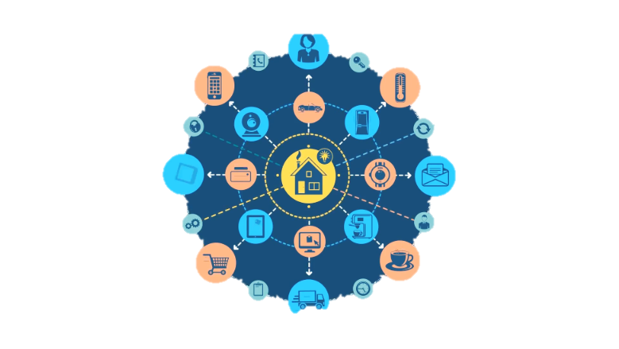
Introduction of IOT?
The Internet of things (IoT) is the network of physical objects or “things” embedded with electronics , software , sensors , and network connectivity, which enables these objects to collect and exchange data.

Slide 5
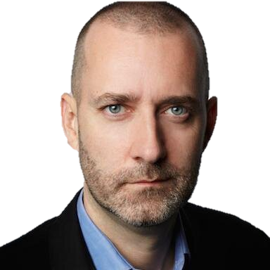
History:-
Kevin Ashton-
“Father of IoT”
1999 Kevin Ashton coins the term
“Internet of things”and establishes MIT’s Auto
-ID center,a global research network of academic
Laboratories focused on RFID and the IoT.

Slide 6
Flowchart of IoT:-
Collect
Analyze
Act
Communicate

Slide 7
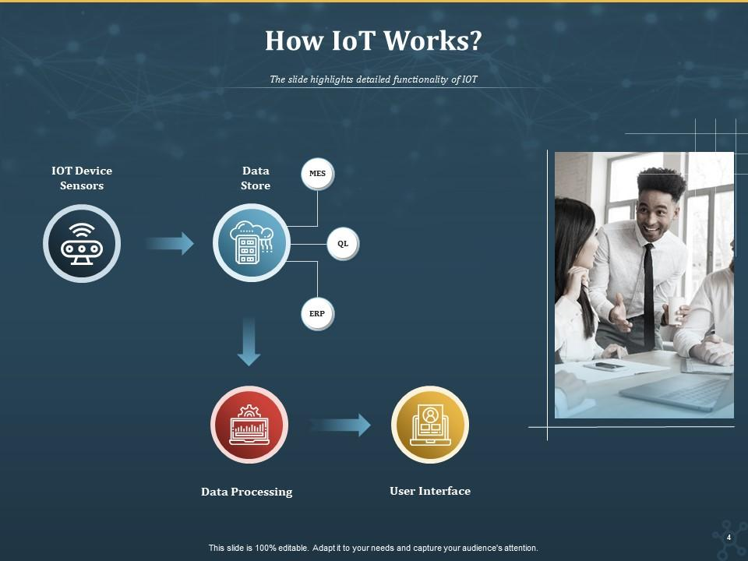
HOW IOT WORKS?

Slide 8
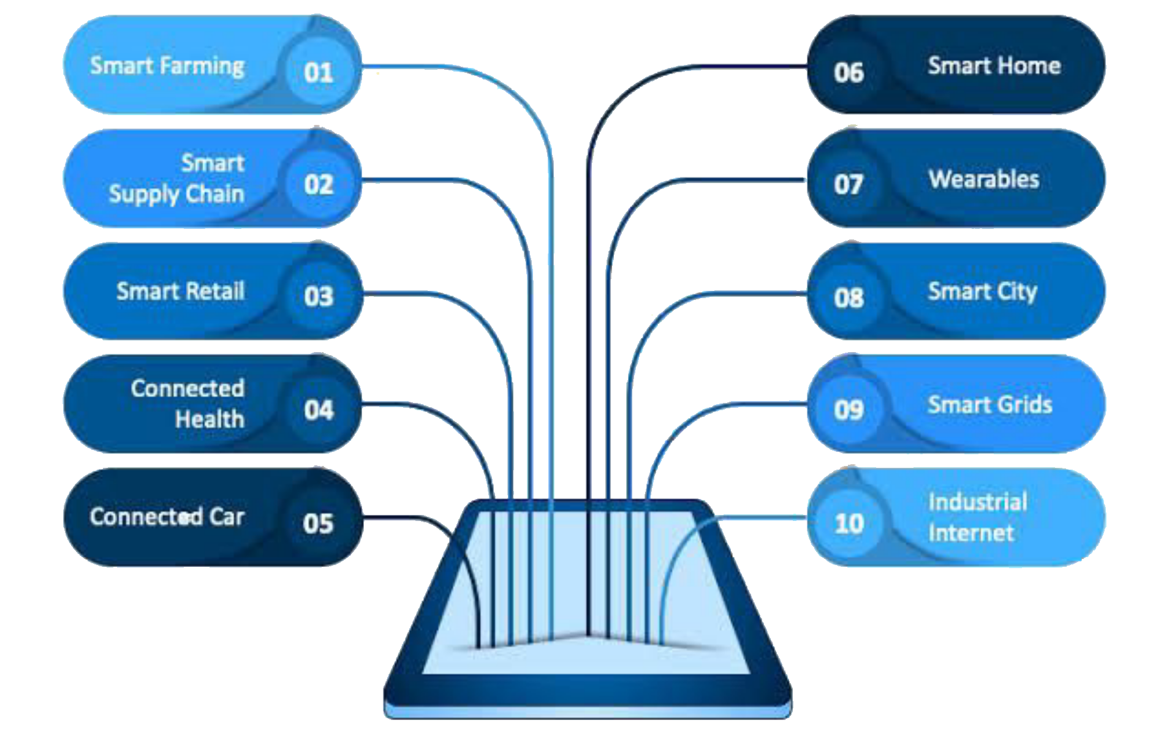
Applications of IOT

Slide 9
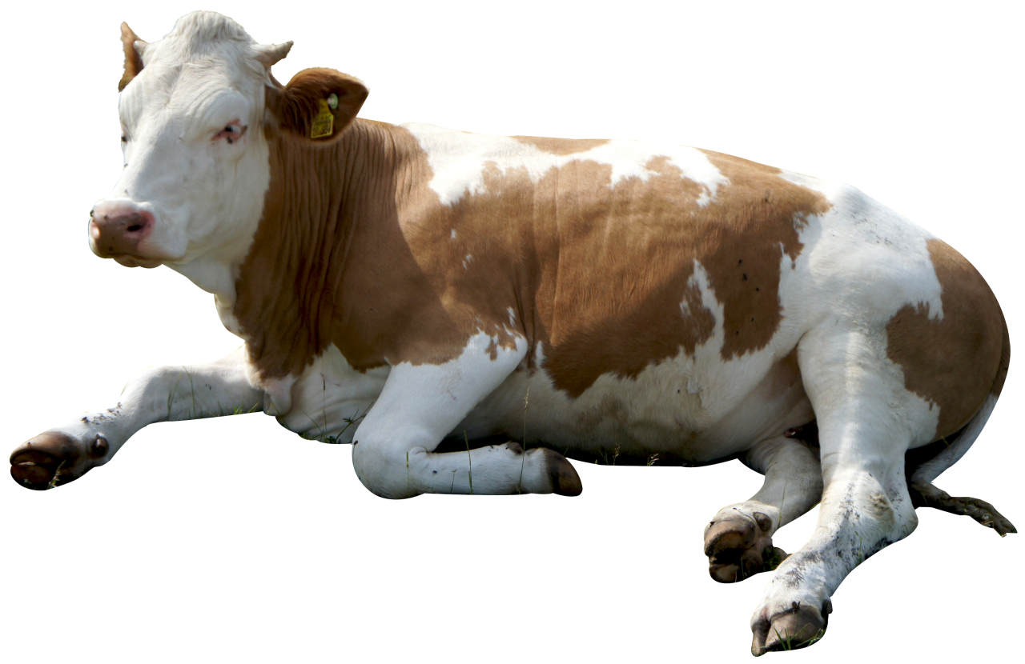
SENSORS IN EVEN IN THE HOLY COW
In the word of IOT, even the cow will be connected and monitored.
Sensors are implanted in the ears of cattles.
This allows farmers to monitor cows ‘health and track their movements , ensuring a healthier
More plentiful supply of milk
On average , each cow generates about 200 MB of information per year.

Slide 10
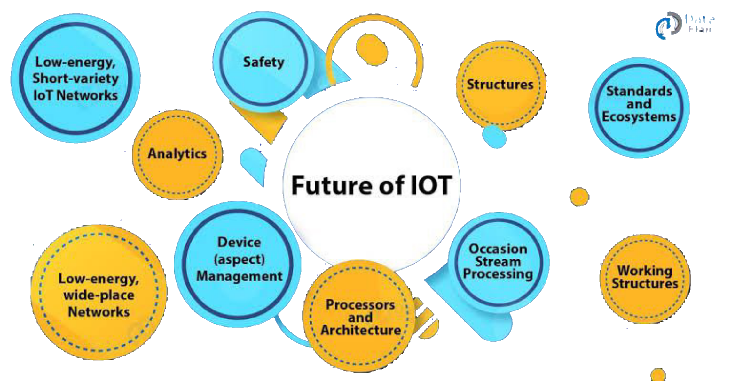
Future scope of IOT:-

Slide 11
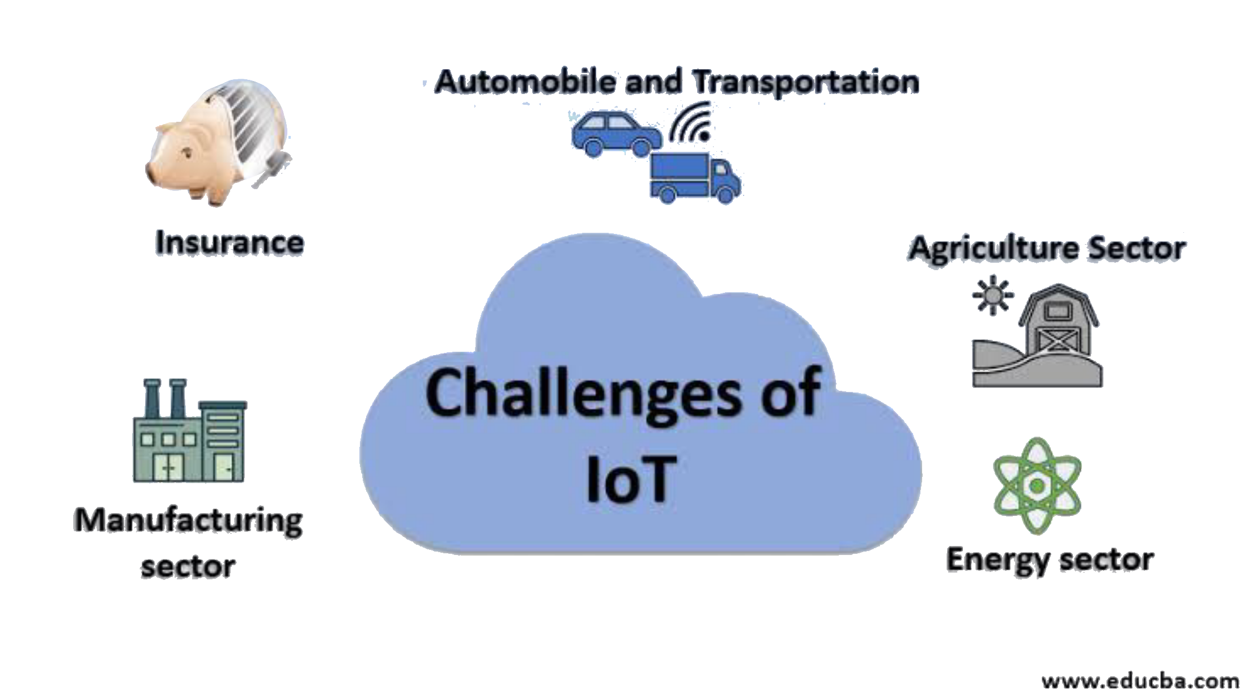
Challenges of IOT:-

Slide 12
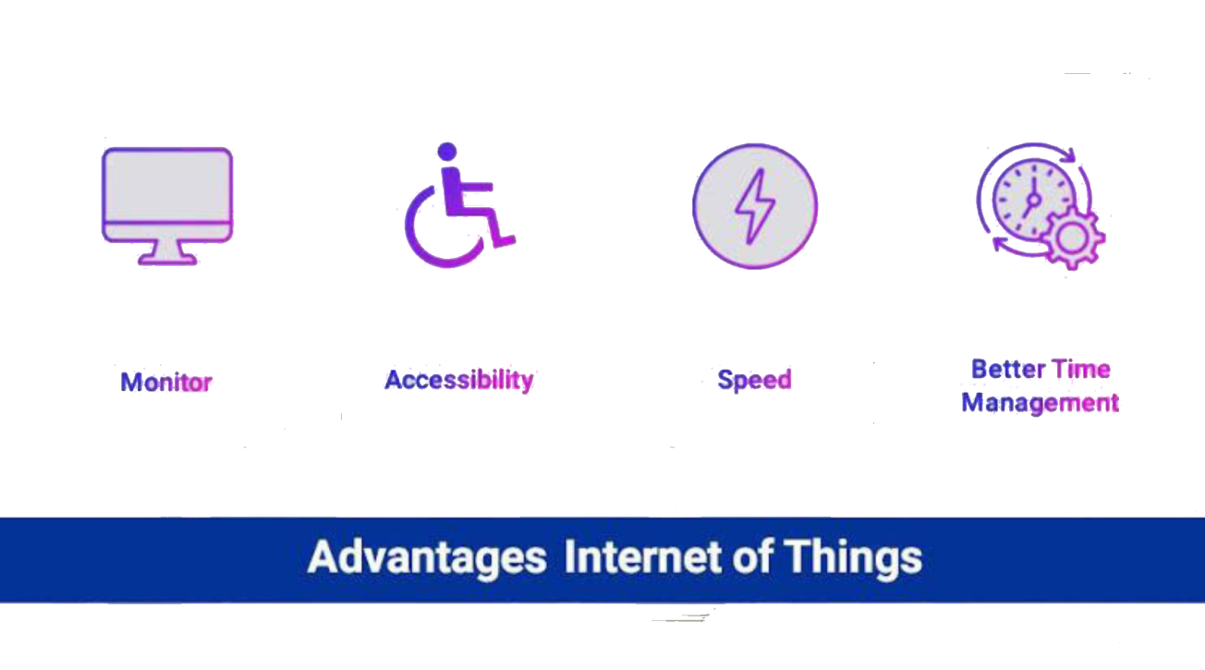
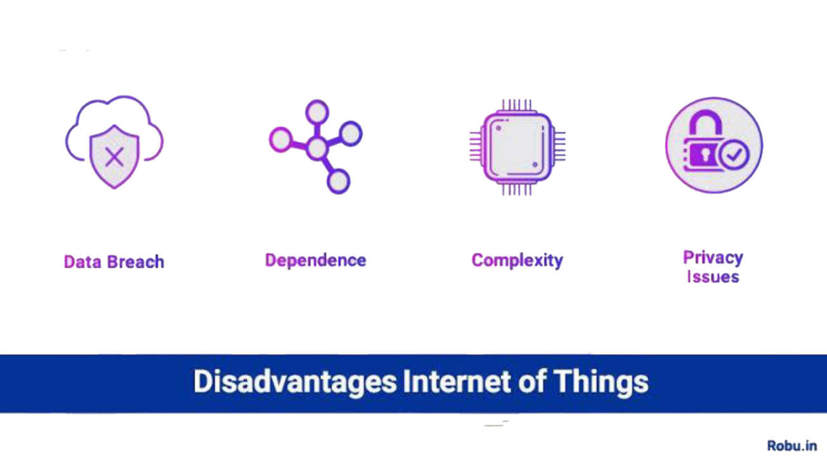
Advantage and Disadvantage:-

Slide 13

THANK YOU

